Slide 1
Command and Control
Brandon Moe

Slide 2
Todays Topics
More Command and Control

Slide 3
Quick Review

Slide 4
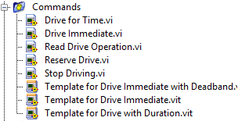
Commands
Commands are the actions you want to preform
These will be placed in teleop
Anything you want the robot to do needs a command
In C++ these are called header files example.h

Slide 5
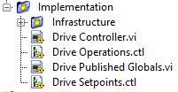
Implementation
These is where you will execute actions that your command calls
All movement on the robot is executed here
In C++ these are known as source file example.cpp

Slide 6
Tips, Tricks, and Need To Knows

Slide 7
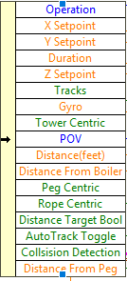
What setpoints should I use?
If your command needs a value it needs a setpoint. Here is the list of setpoints we had on the 2017 drivetrain
And yes every single one was used

Slide 8
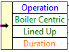
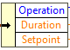
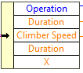
Other setpoints from 2017
Ball Shooter
Gear Manipulator
Climber
Ball Intake

Slide 9
What about opperations?
All commands need an operation.
GIVE THESE OPPERATIONS MEANINGFULL NAMES!!!!!!!!!!!!!!!!!!!!!
The operation should say EXACTLY what the robot will do.

Slide 10
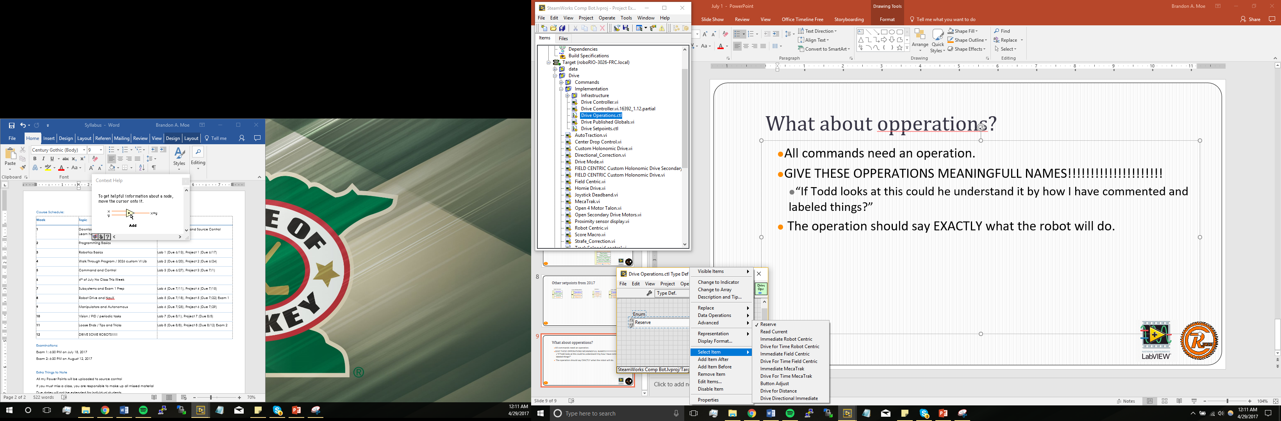
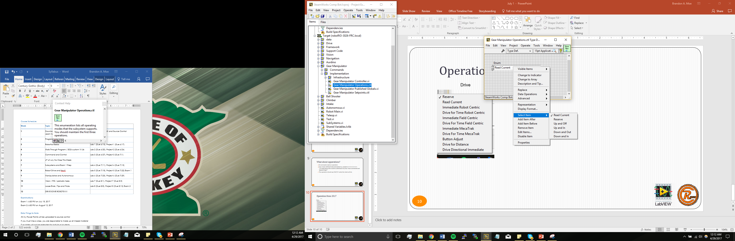
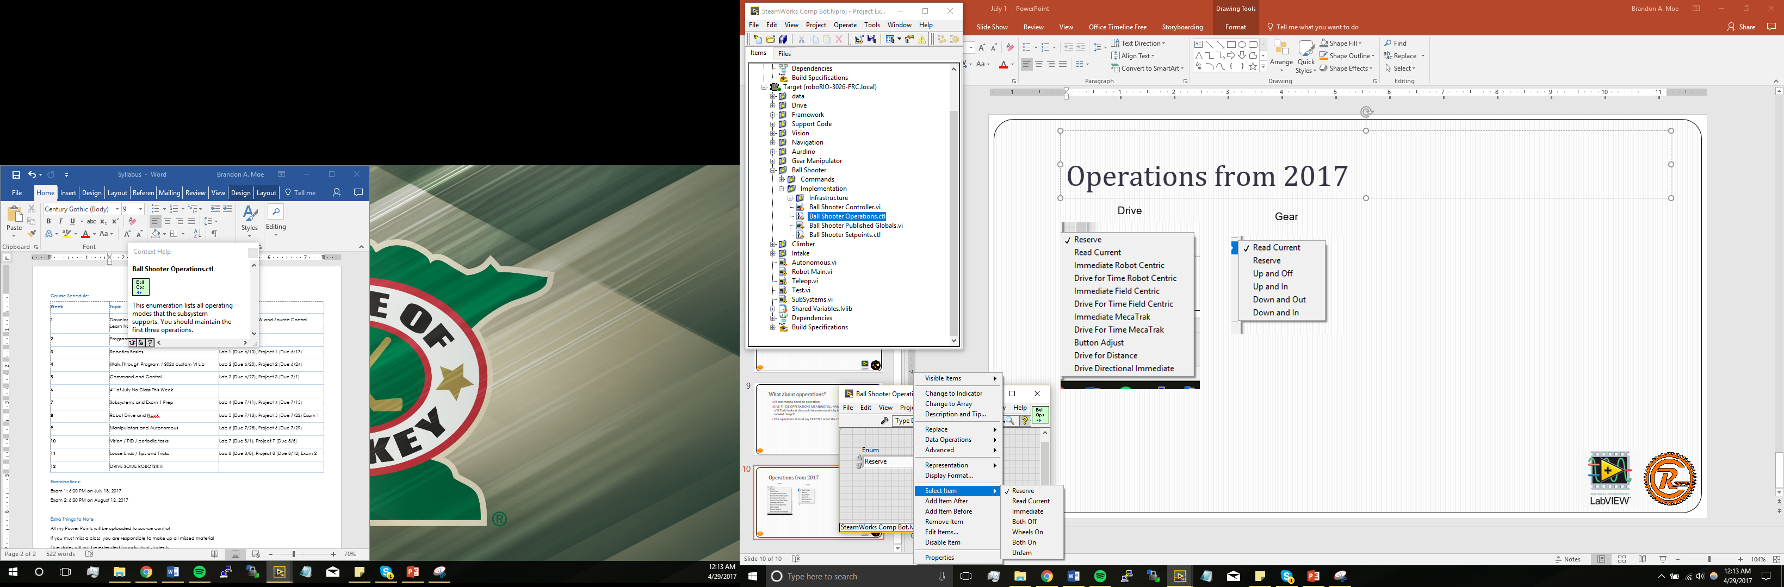
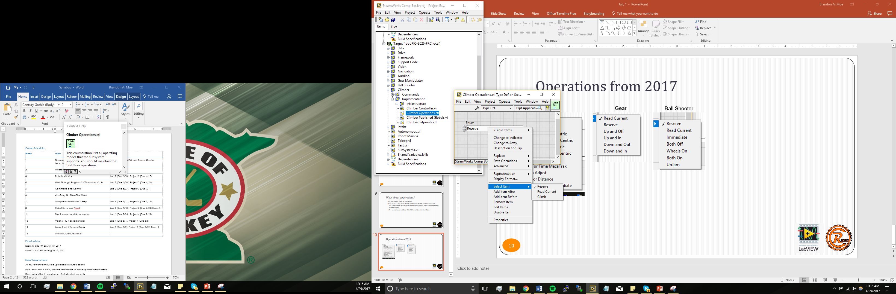
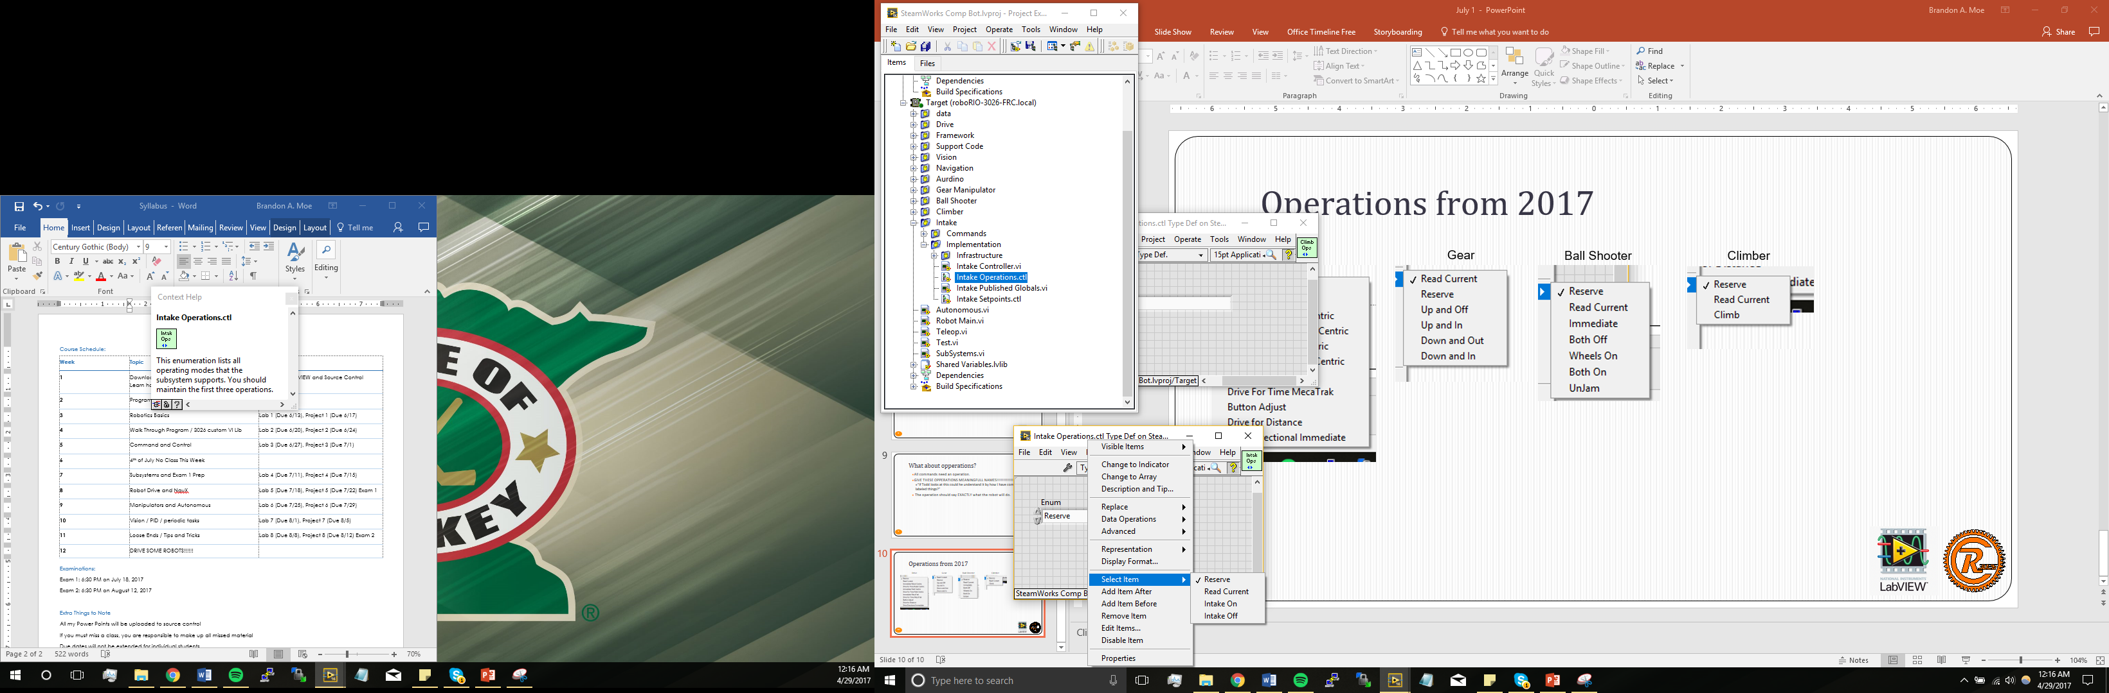
Operations from 2017
Drive
Gear
Ball Shooter
Climber
Ball Intake

Slide 11
ATTENTION
Never delete the reserve or current operation. You will break so many things in your program it isn’t even funny.
I learned the hard way

Slide 12
Controller
This is where you program the functions of each command.

Slide 13
What goes in each operation
Reserve
What the default state of the thing you are programming will be
Read Current
Reads the current operation
Others

Slide 14
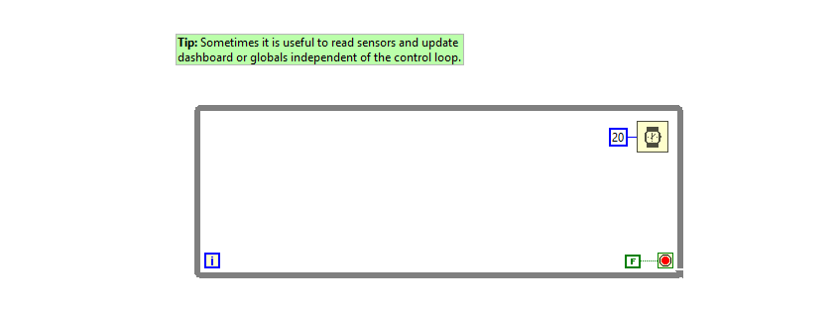
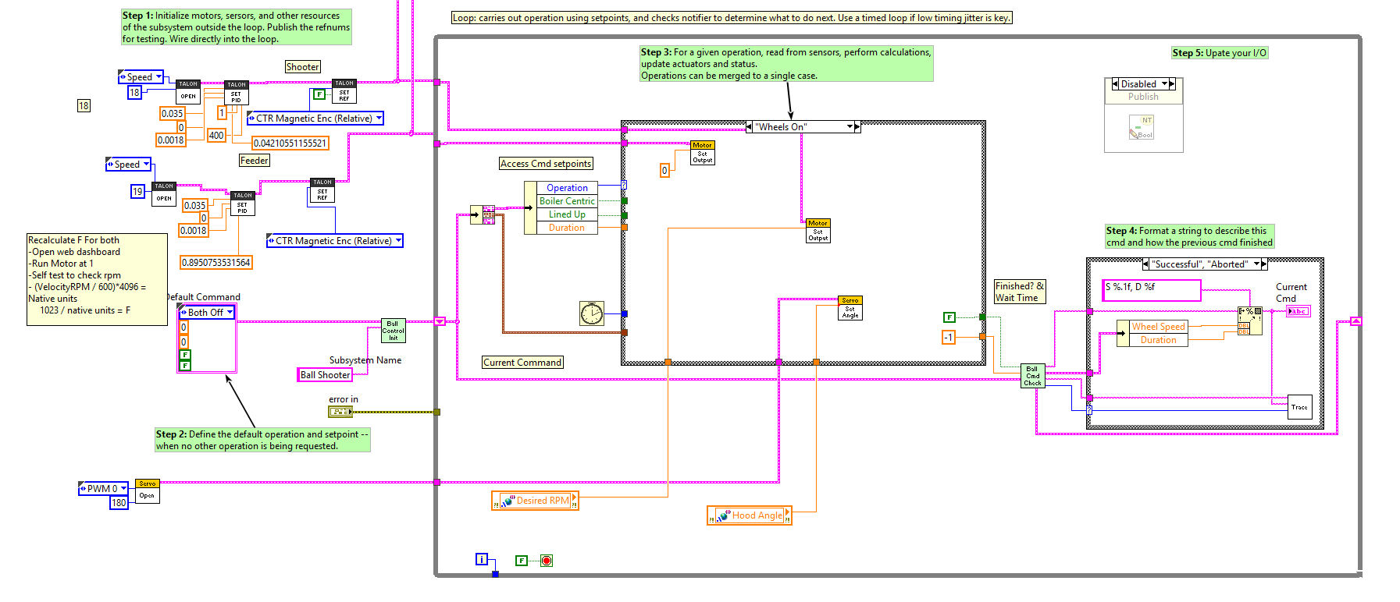
Sensors
Initialize
Operations Functions
Execution Type

Slide 15
Initialize
Outside of the while loop
This section of code will run once
This is where you will initialize anything for that particular subsystem
Motors
Sensors
Solenoids

Slide 16
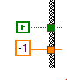
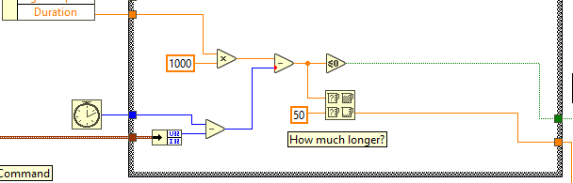
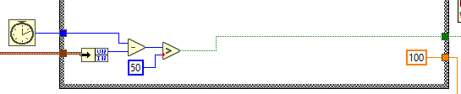
Different operation executions
Waits for Next Command
Execute for time
Execute with delay for next command

Slide 17
Operations functions
This is where you will program what will need to be done
Motor movements
Solenoids moving

Slide 18
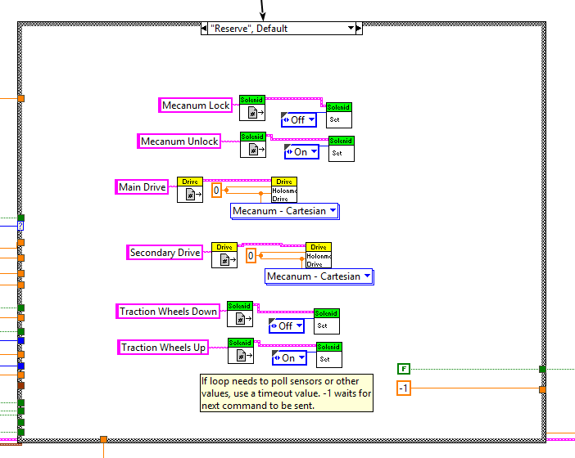
Reserve
The default state of everything in the subsystem

Slide 19
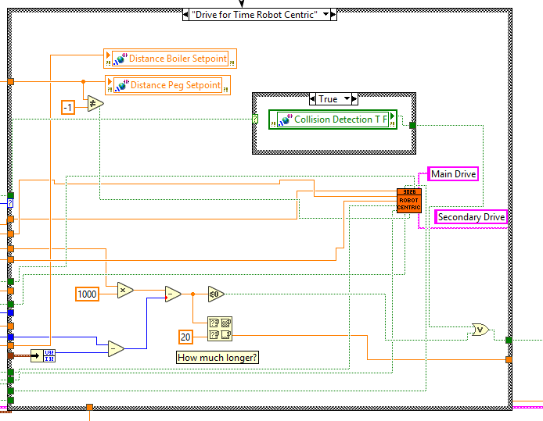
Example Operation

Slide 20
Steps for making a subsystem

Slide 21
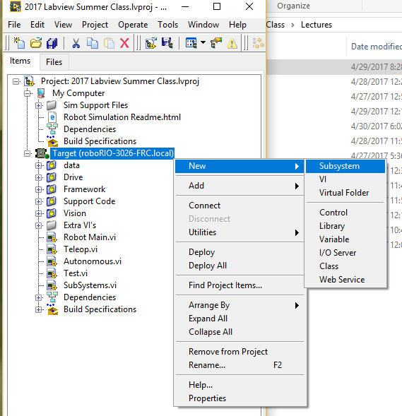
Step 1
Right Click on target and select New -> subsystem
Make a new subsystem

Slide 22
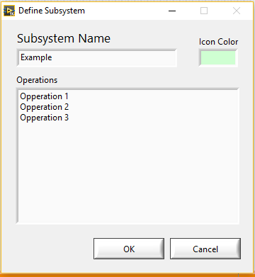
Step 2
Name and give operations

Slide 23
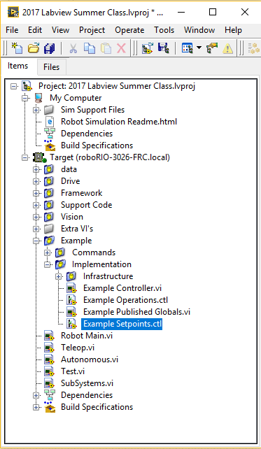
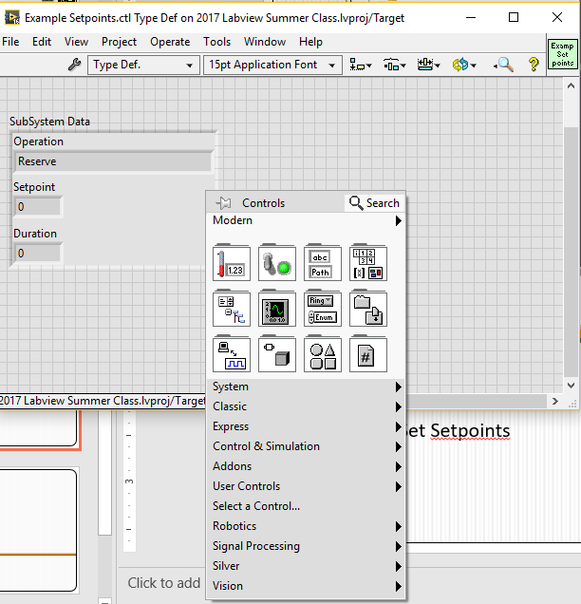
Step 3
Make all setpoints that you will need for every command you plan on having. These include boolean, doubles, and string.
Set Setpoints

Slide 24
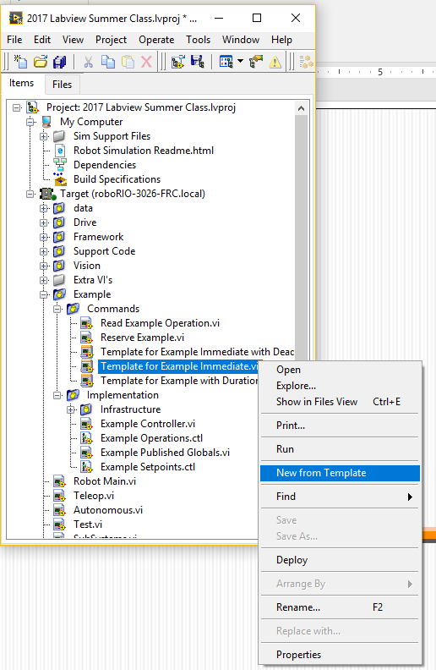
Step 4
New Command

Slide 25
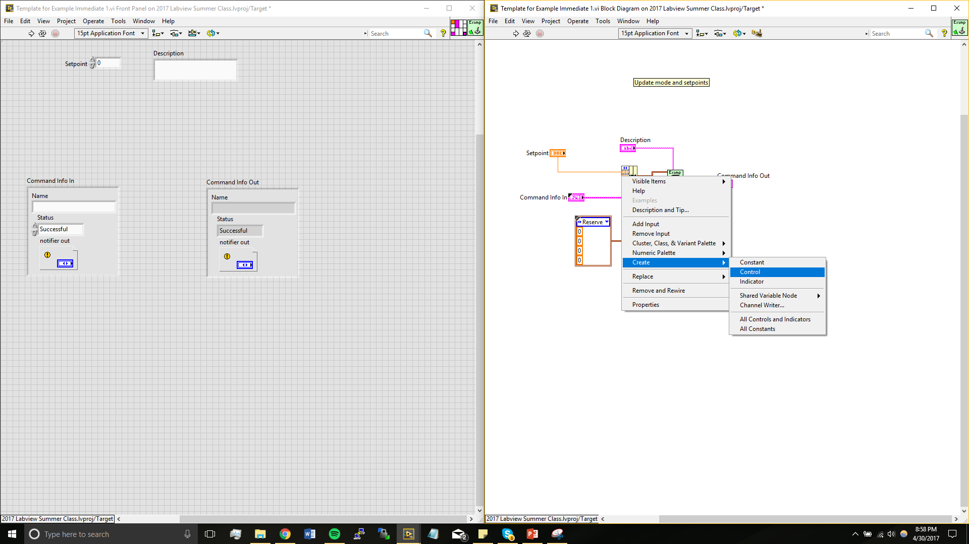
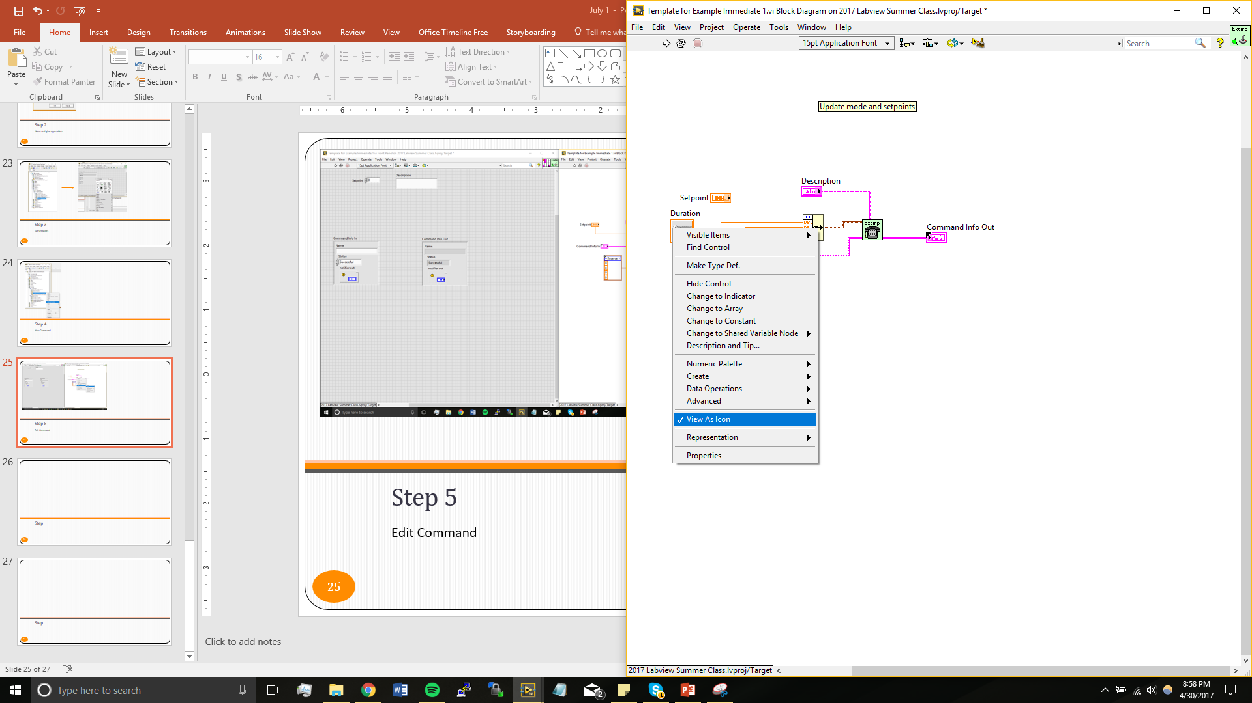
Step 5
Don’t View as icon. It makes it look nicer
Give all setpoints needed a control

Slide 26
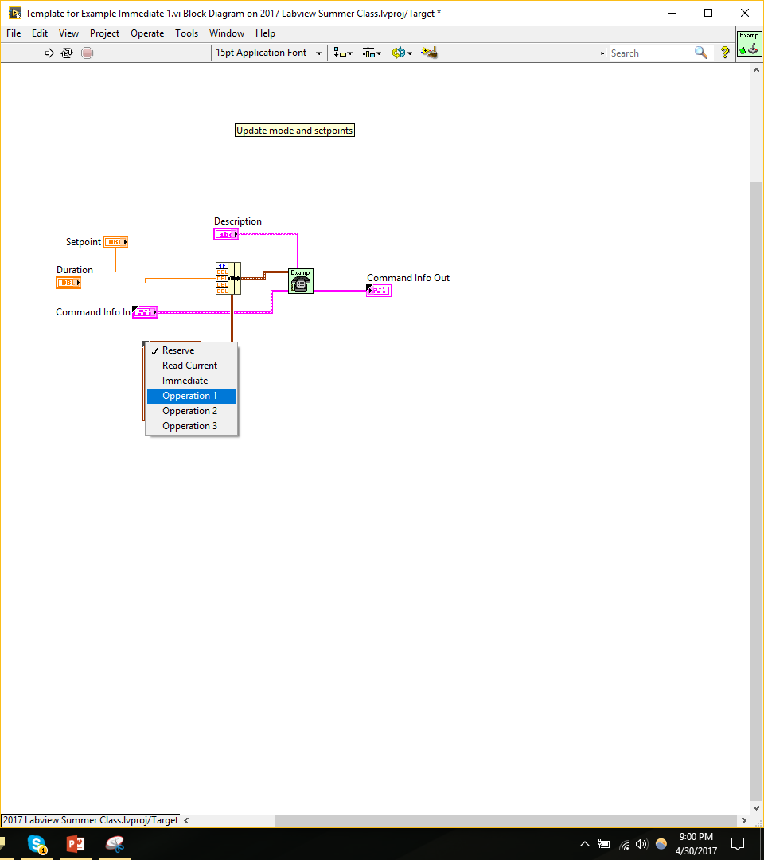
Step 6
Click on the blue box and select the operation that you want this to be.
Set the operation

Slide 27
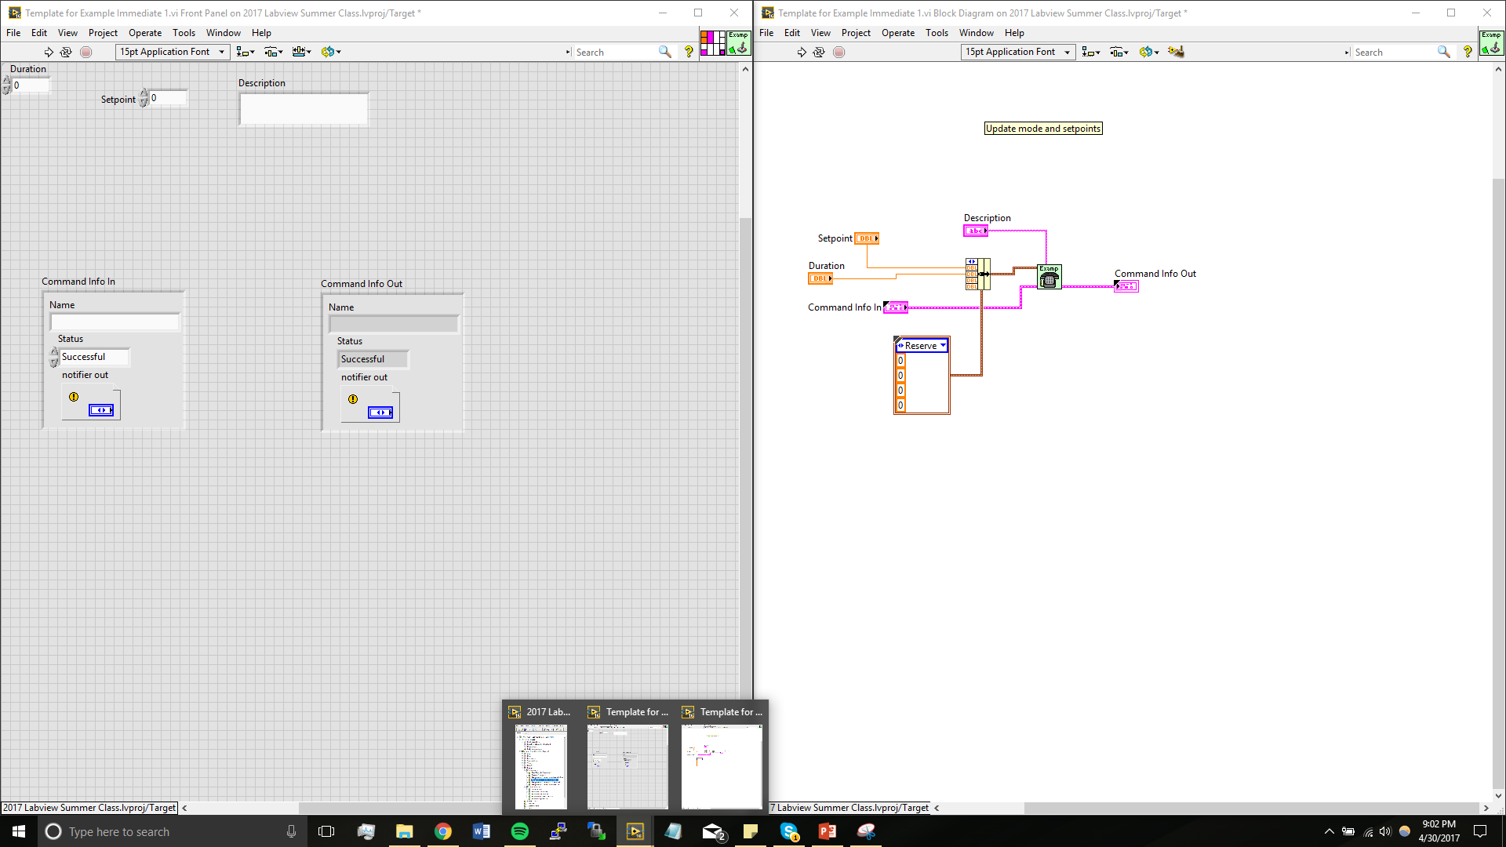
Step 7
Terminals
Setpoints
You will do this by clicking on a terminal slot, then clicking on the setpoint you would like in that place
Attach setpoints to terminals

Slide 28
Repeat steps 4-7 for all commands

Slide 29
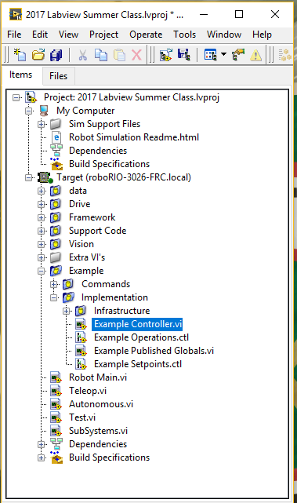
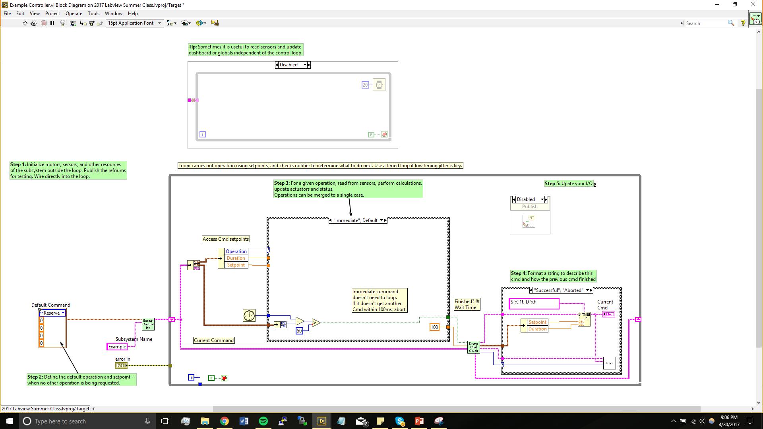
Step 8
Go to controller

Slide 30
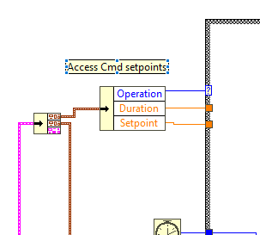
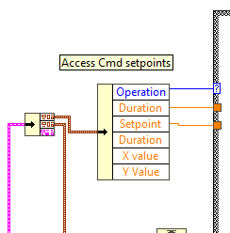
Step 8
Drag the bottom of the setpoint cluster until all setpoints are present
Make all setpoints visible

Slide 31
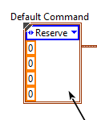
Step 9
Make sure the default operation is reserve

Slide 32
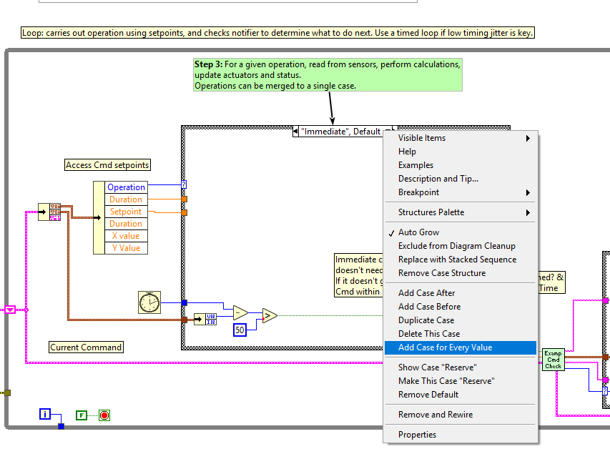
Step 10
Right Click on the text box of the case structure. Then select “Add Case for Every Value”
Add case for every value

Slide 33
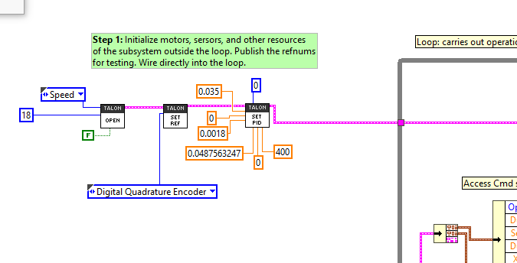
Step 11
This would be an example motor on an SRX with PID
Initialize everything you will need

Slide 34
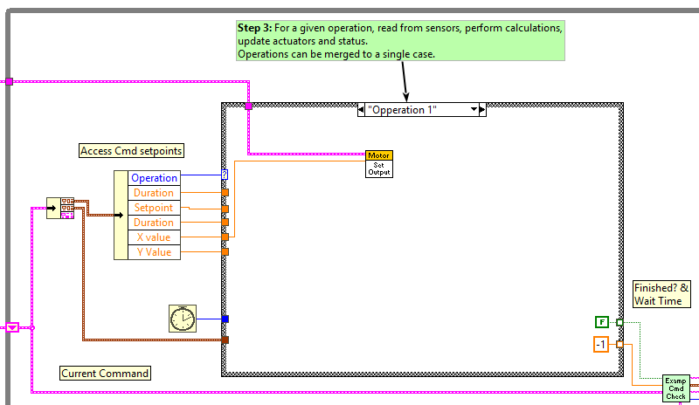
Step 12
Set what each operation will do and its execution type. Repeat for every operation

Slide 35
You have now made your subsystem!
Next class we will learn how to use this to execute tasks.

Slide 36
Lab 4
Make a new subsystem named Intake
Operations
Intake forward
Intake Reverse
Setpoints
Wheel Speed
Make this a Talon SRX
CAN 12

